Slide 1

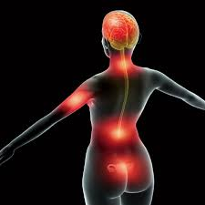
A simple Test to assist Doctors with detecting pain

Slide 2
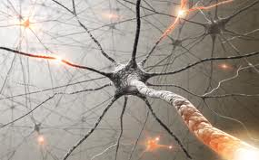
The Problem
Diagonising nerve cancer (or other illnesses where pain is a major symptom).

Slide 3

The Complication
Doctors do not have enough time to talk with every patient.
Pain scales are hard to get a helpful response from.

Slide 4
A Solution (POC)
Create an automated program that patients can use to indicate how much pain they are in.
Images give the patient a context of how much pain is normal.
Needs minimal interaction from a busy doctor.
Further builds can automatically email for further support for critical conditions.

Slide 5
http://www.codeskulptor.org/#user33_rC6wx5Ss5s_6.py
Proof of Concept:

